Slide 1
0g
Tare

Slide 2
1600g
0g
Tare

Slide 3
0g
Tare

Slide 4
-1600g
0g
Tare

Slide 6
-1600g
2000g
Tare

Slide 7



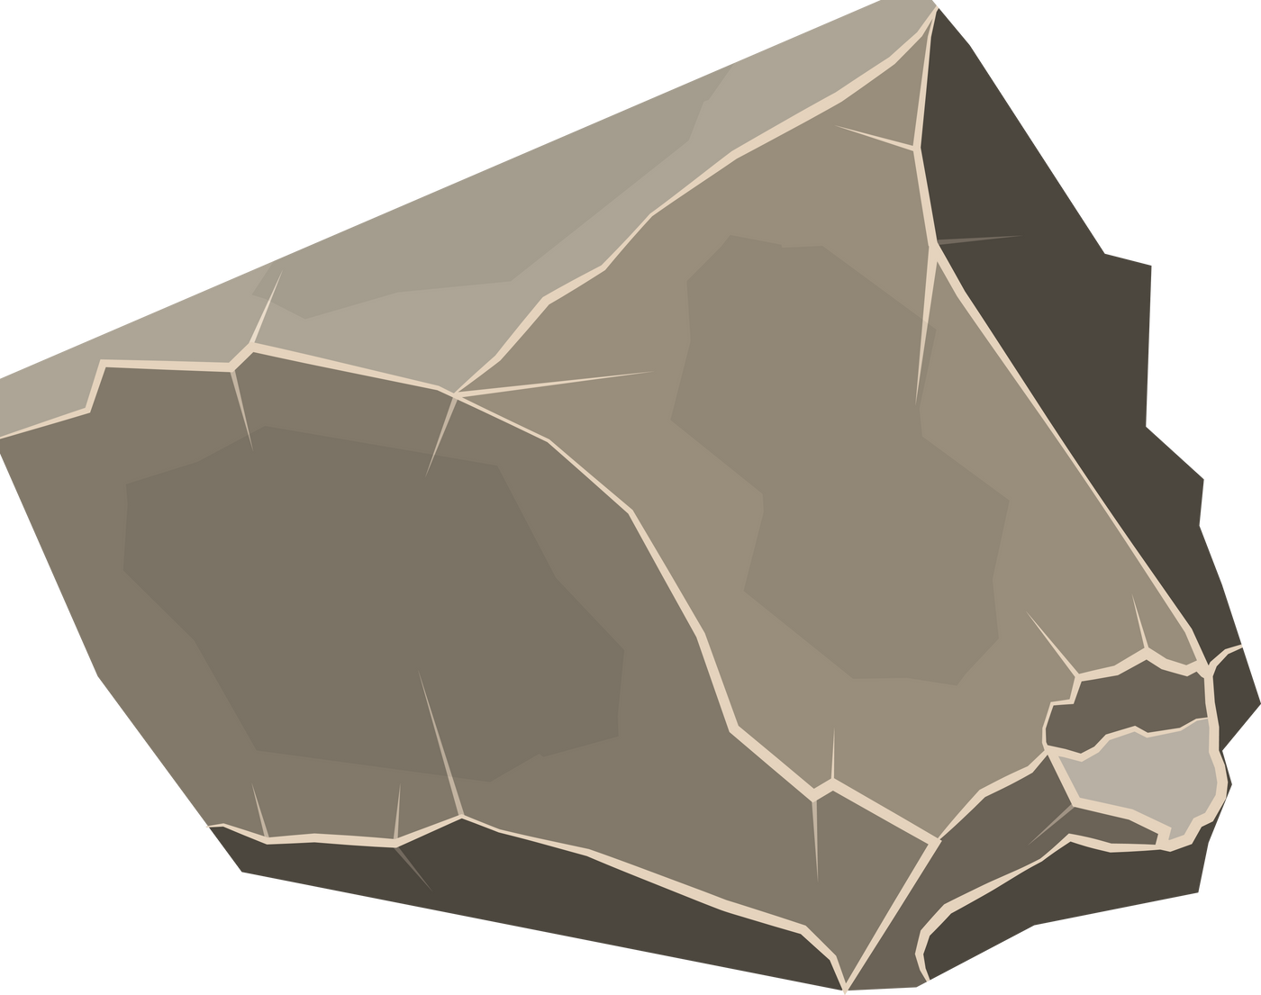
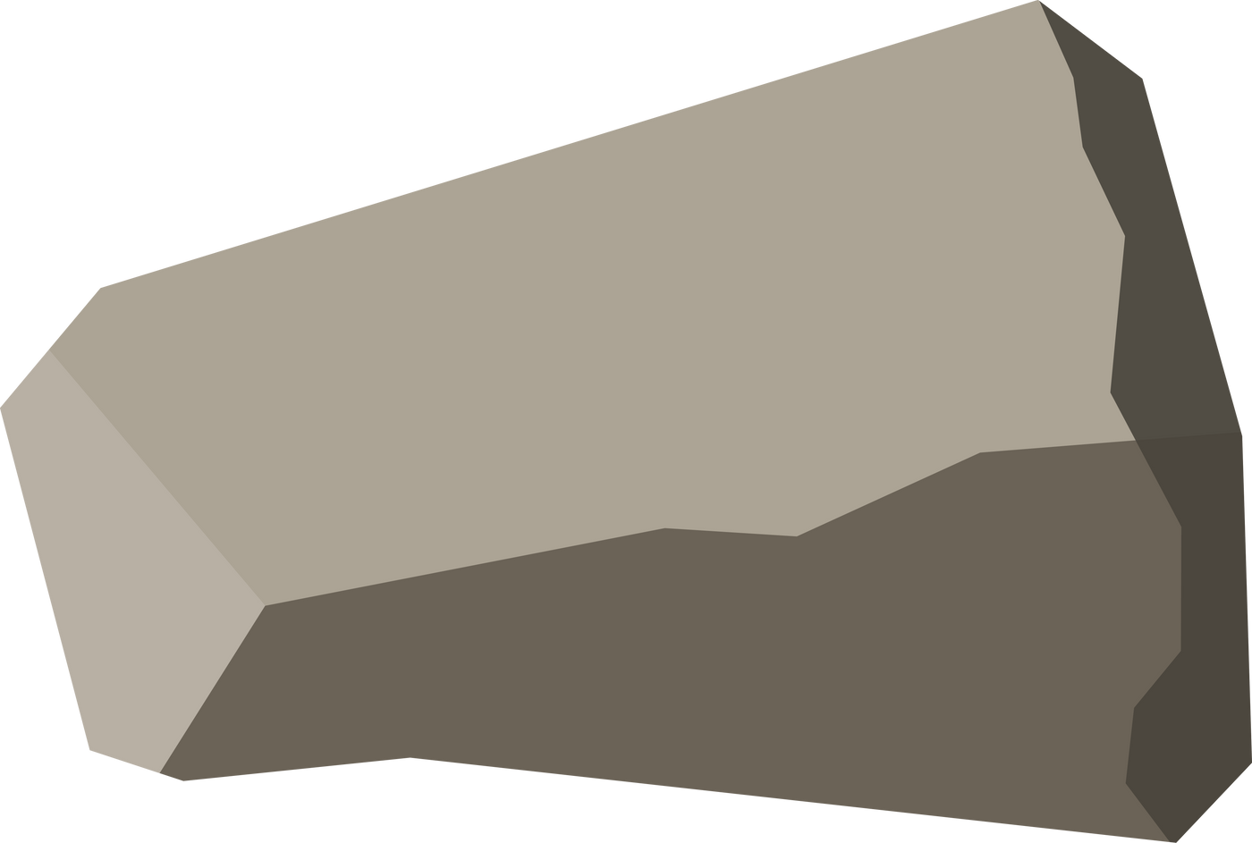
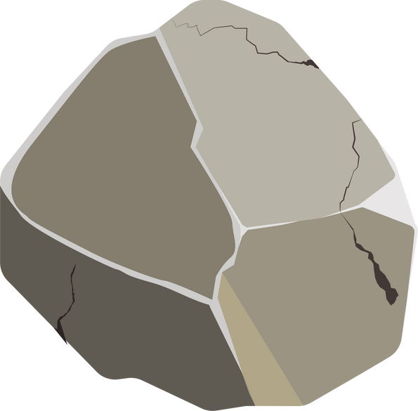

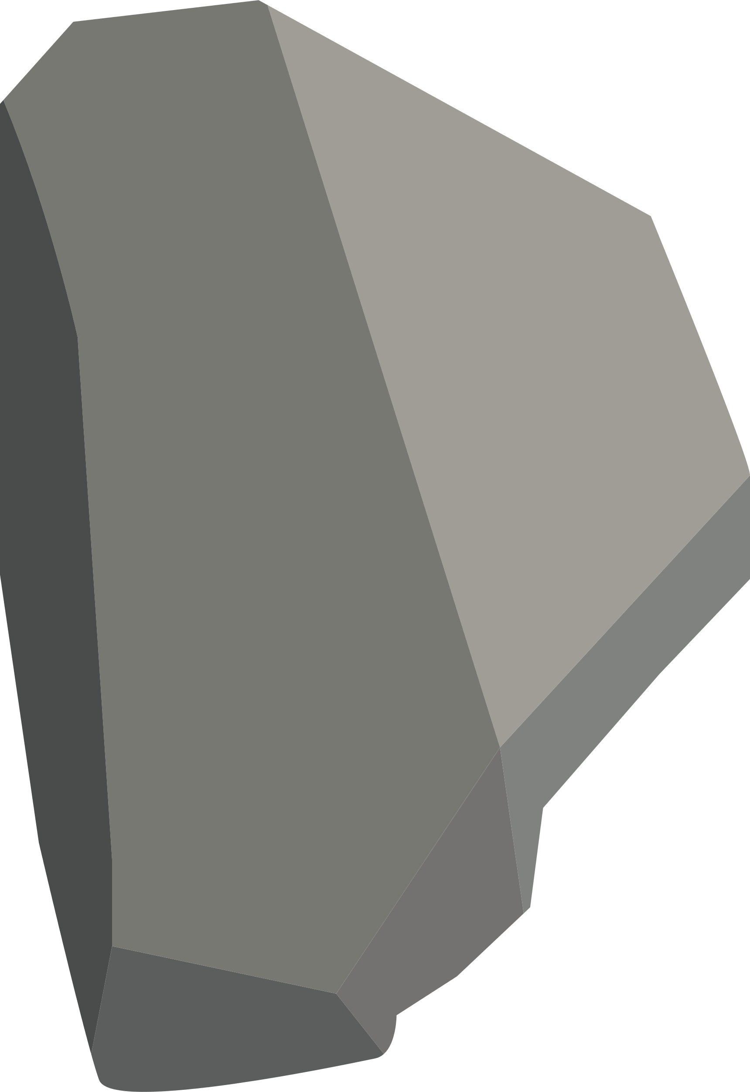
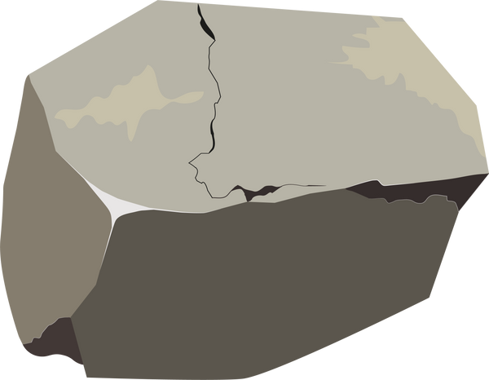
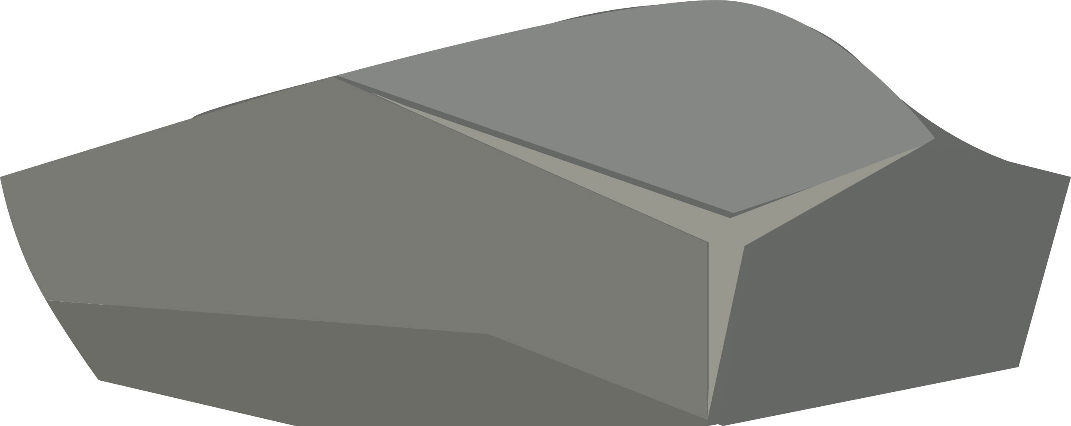






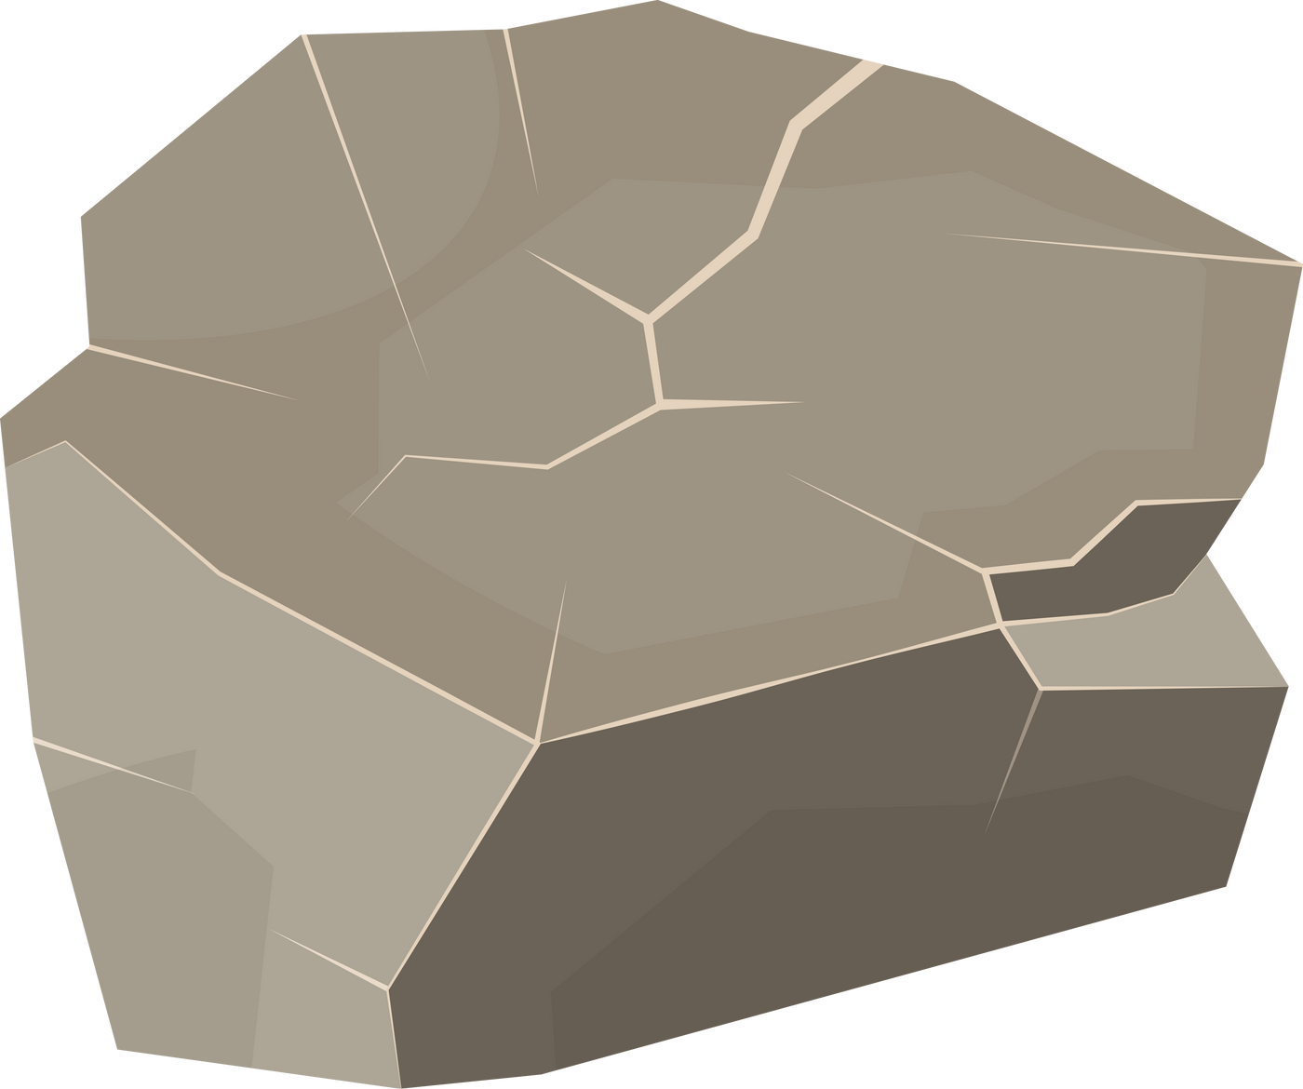




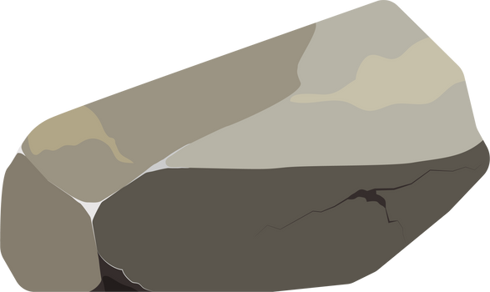

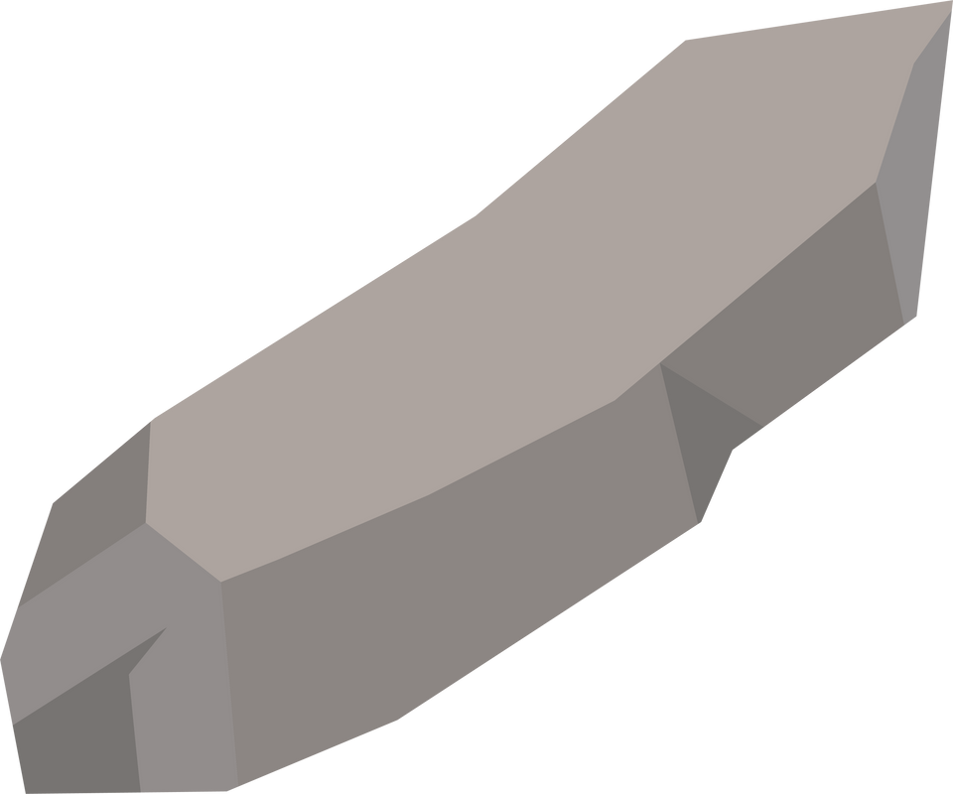
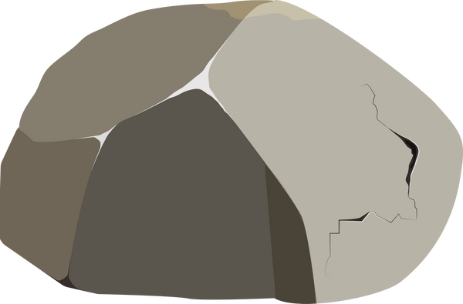
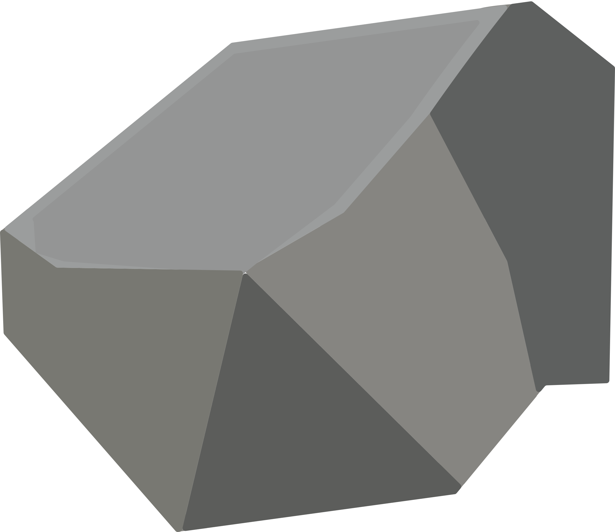


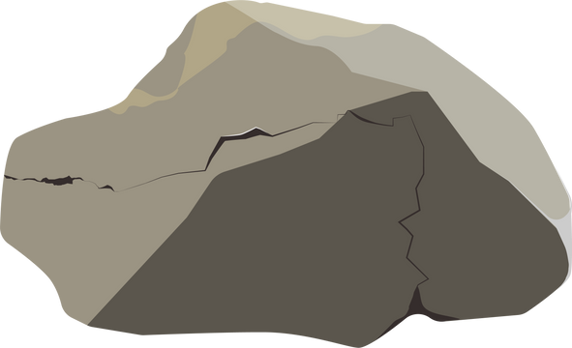
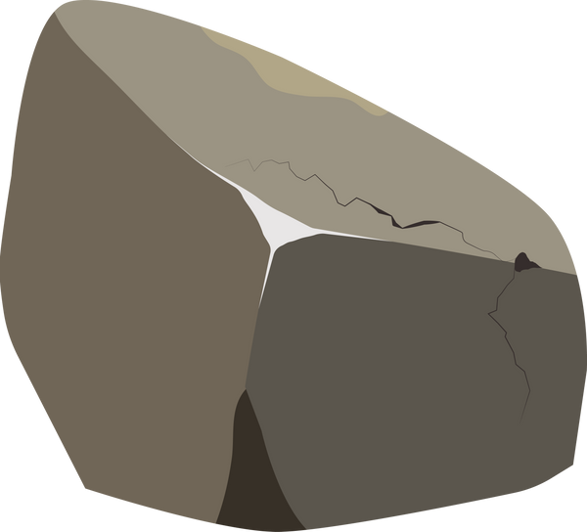
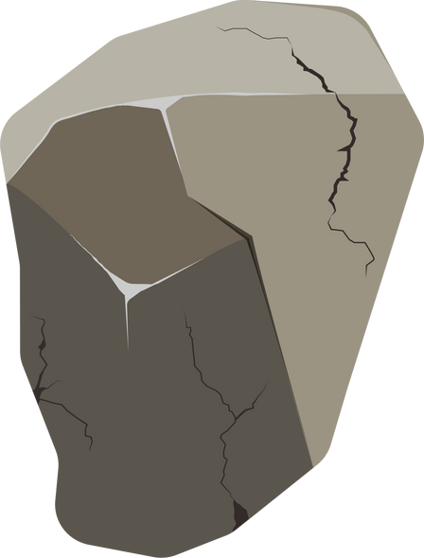


Slide 11
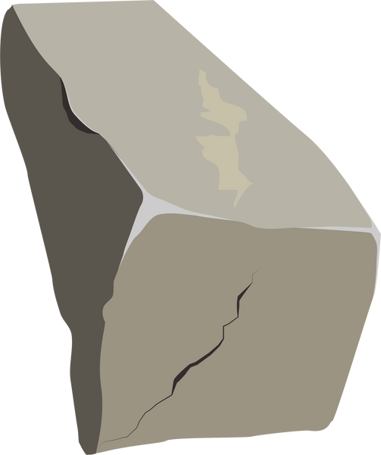
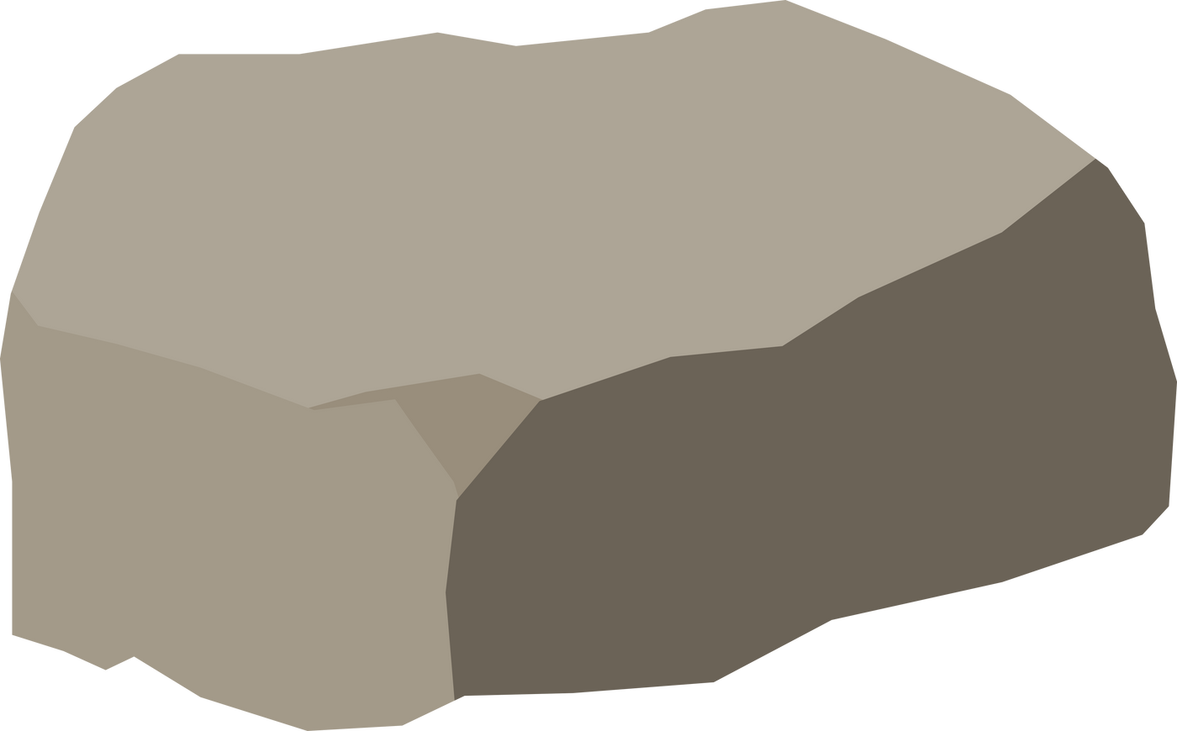

Slide 14
3000g
-1600g
Tare

Slide 15
1600g
0g
Tare

Slide 22
0g
Tare

Slide 23
0g
Tare

Slide 24
0g
Tare

Slide 25
0g
Tare

Slide 28
Descriptions | Volume of metal measures, V1(ml) | Volume of water required to fill the metal measures containing | Percentage of Voids, (V2/V1)x100
Trial No. 1
Trial No. 2

